Slide 1
Concept of Phonons
and
Concept of Brillouin Zone
Dr. Elangovan Elamurugu
iDARE Laboratory, Department of Physics and Nanotechnology, SRMIST

Slide 2
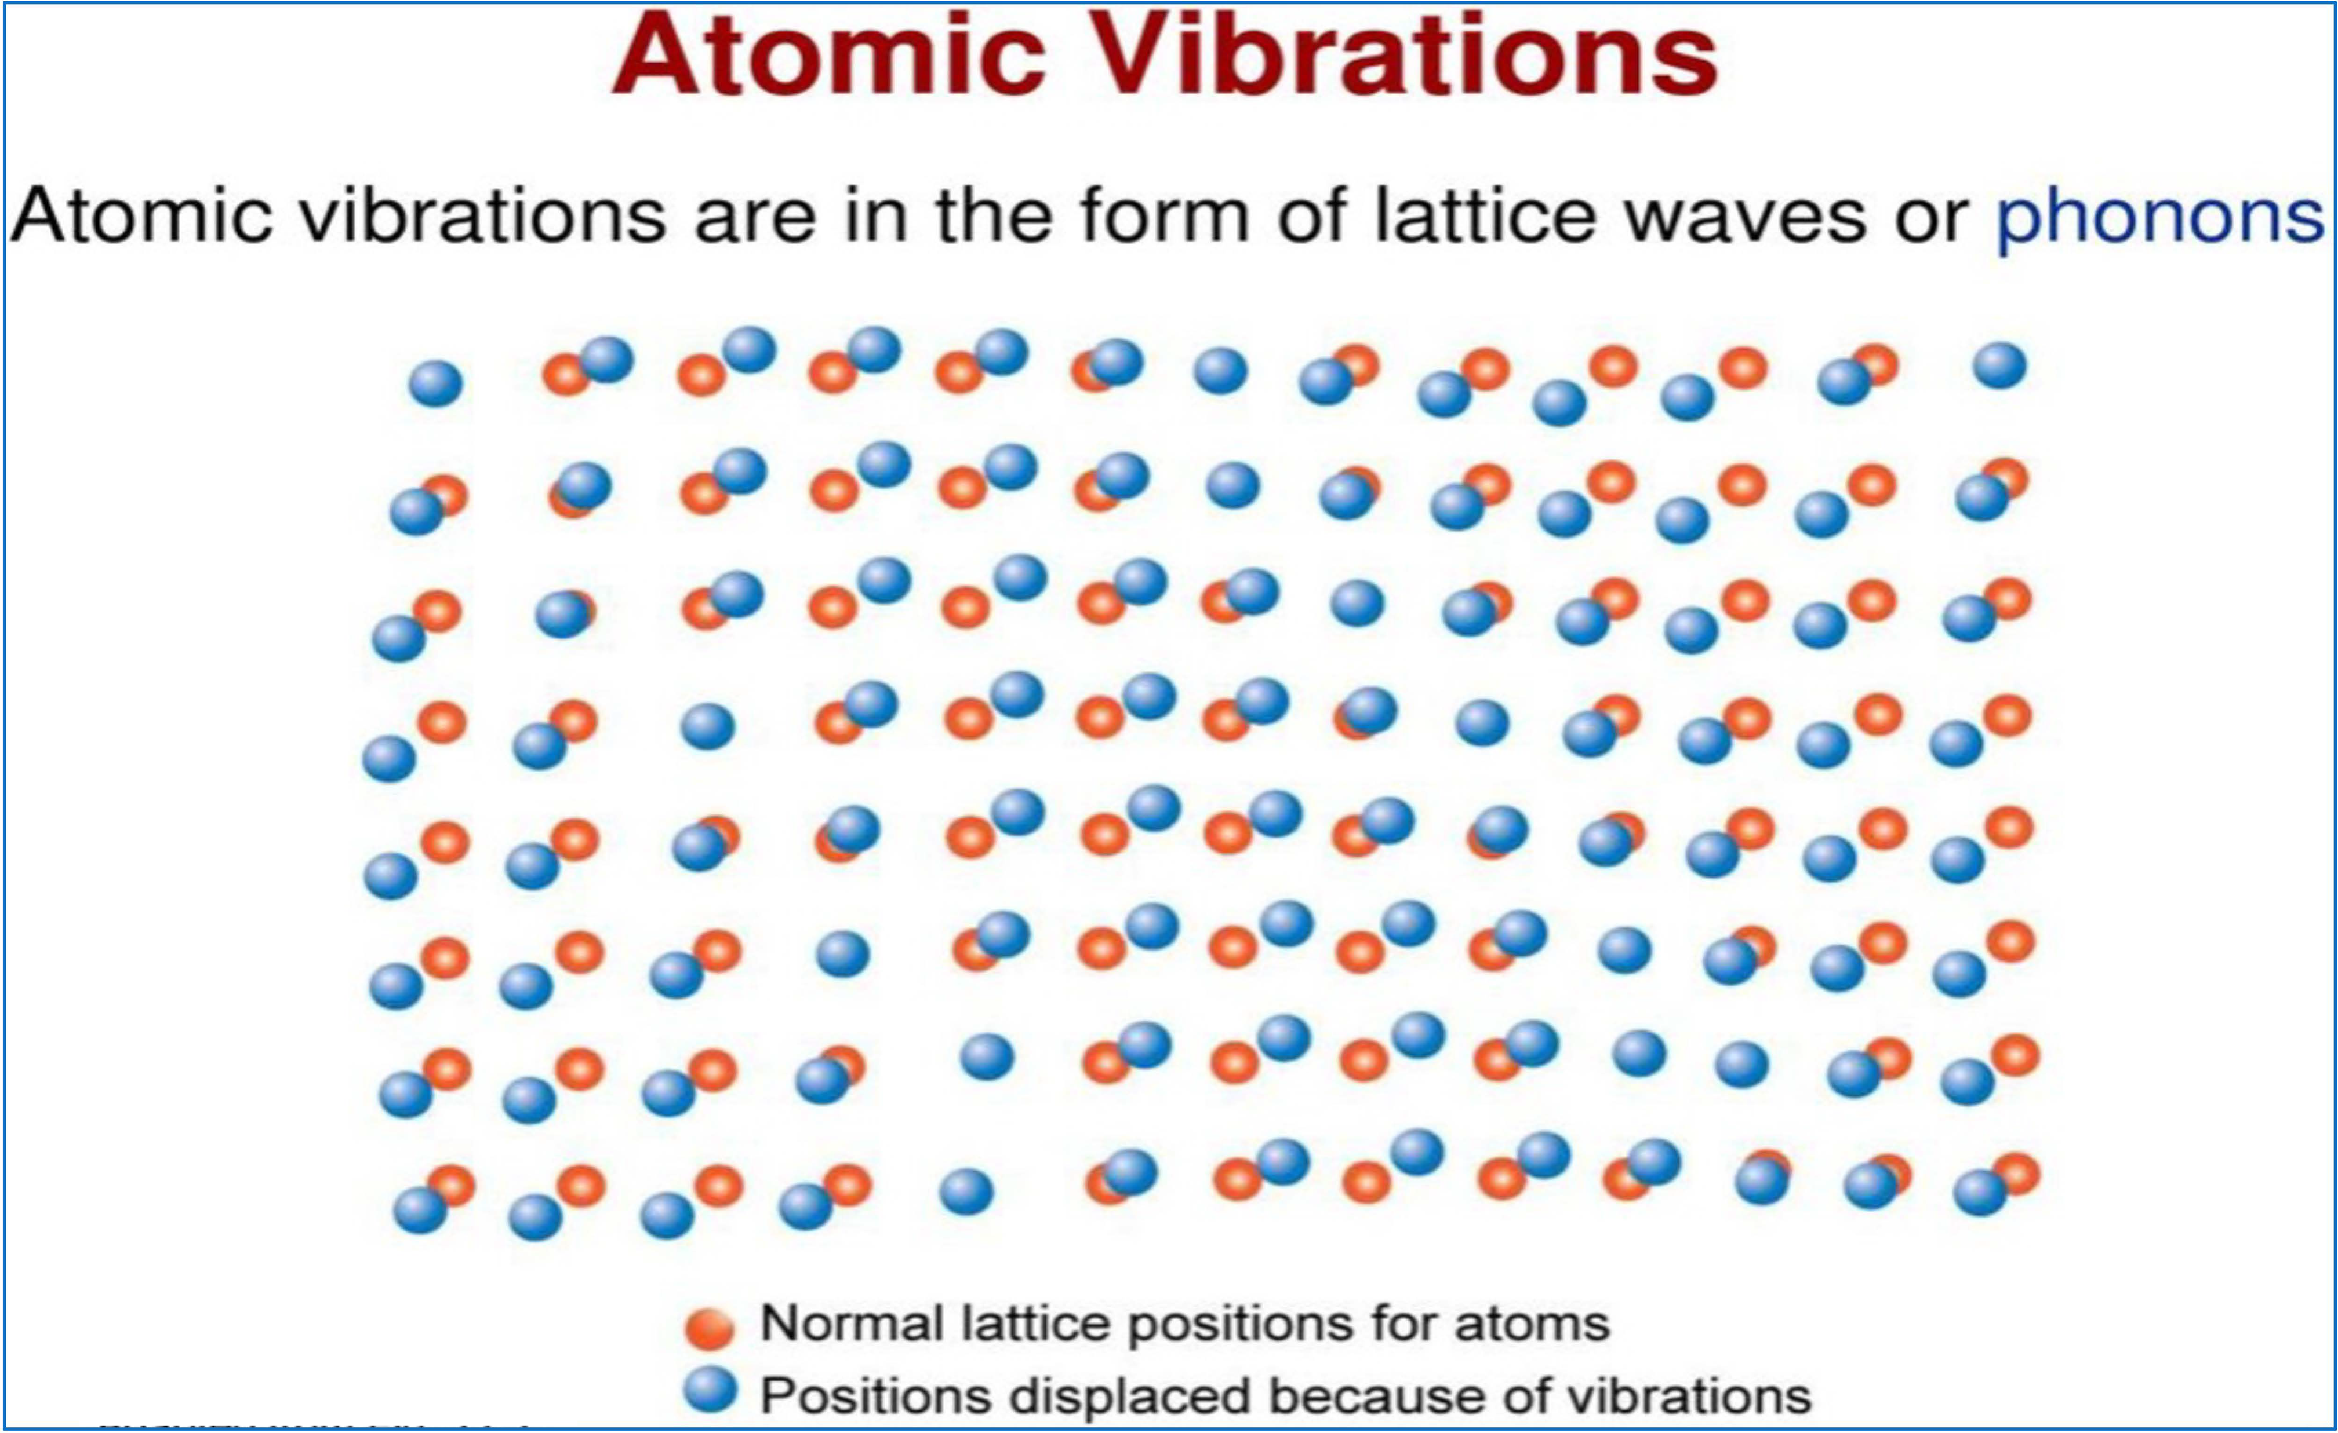
Concept of Phonons
Any solid crystal consists of atoms bound into a specific repeating three-dimensional spatial pattern called a lattice.
Here the atoms behave as if they are connected by tiny springs, their own thermal energy or outside forces make the lattice vibrate.
This generates mechanical waves that carry heat and sound through the material.
A packet of these waves can travel throughout the crystal with a definite energy and momentum, so in quantum mechanical terms the waves can be treated as a particle, called a phonon.
A Phonon is a definite discrete unit or quantum of vibrational mechanical energy, just as a photon is a quantum of electromagnetic or light energy.
https://www.youtube.com/watch?v=87UtD-5bbL4

Slide 3
Concept of Phonons
Like Photon is the smallest unit of Light, Phonon is the smallest unit of Sound. In a lattice structure, vibrations are created by atoms. The quantized, lowest state energy of vibration is called phonon.
Atoms are considered as rigid, with atoms stuck in their lattice. In reality, atoms can be considered as simple harmonic oscillators. The harmonic oscillator has a ground state energy and an associated vibrational mode even at 0 K.
It is named phonons because at high energy levels long wavelength phonons give rise to sound. According to quantum mechanics, similar particles have wave nature, waves must also have particle nature. So, phonon is also treated as quasi particle. Similar to particles, these waves can carry heat, energy and momentum throughout the crystal.
In solid state physics, the elementary particles are electrons; the arrangement of electrons will help determine the electrical properties of materials. Whereas, the speed of sound through material and heat required to change its temperature is given by phonons. Another important application of phonons is in the field of superconductivity, where the electrical resistance of certain materials become near absolute zero.
In ordinary crystals, there is a loss of energy in the form of heat as the electrons collide with impurities. But in superconductors, at low temperatures, they tend to attract slightly because of phonons. Now the movement occur as a coherent group thus minimizing energy loss.
Phonons also have important application in detectors like Cryogenic Dark Matter Search, which aim to detect even the slightest vibration in a crystal lattice caused by even a single phonon.

Slide 4
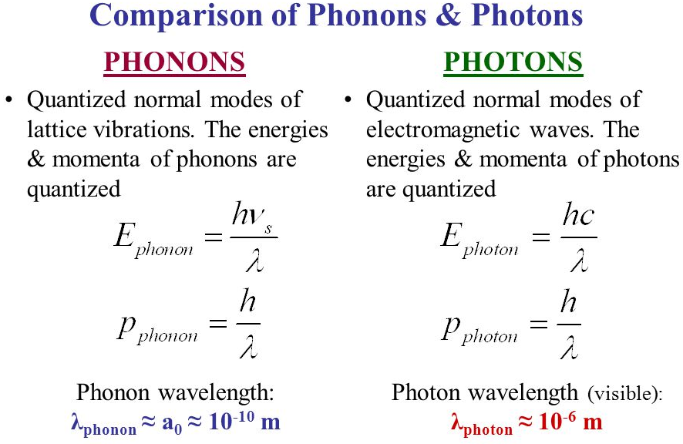
Phonons Vs Photons

Slide 5
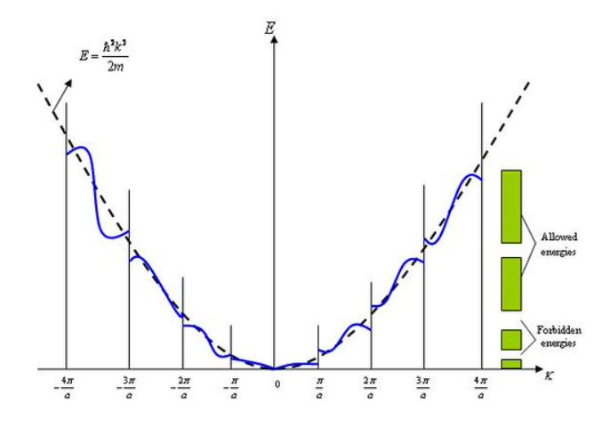
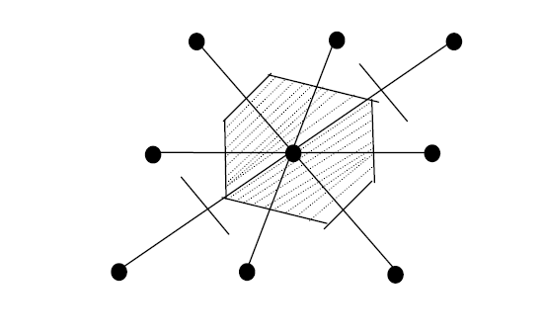
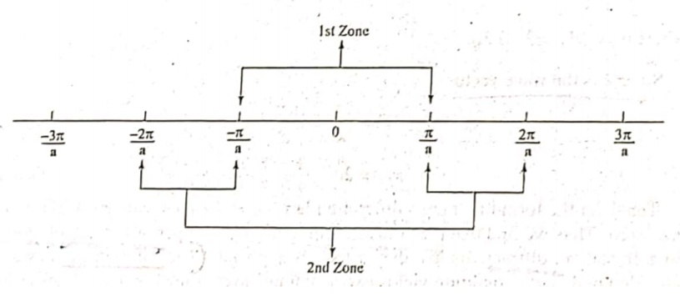
Concepts of Brillouin Zone
The different Brillouin zones correspond to primitive cells of a different type that come up in the theory of electronic levels in a periodic potential.
The first Brillouin zone is considered as the Wigner-Seitz (WS) primitive cell in the reciprocal lattice. In other words, the first Brillouin zone is a geometrical construction to the WS primitive cell in the k-space.
In a direct lattice, the procedure of drawing a WS cell is as follows:
Draw lines to connect a given lattice points to all nearby lattice points.
Draw new lines or plane at the mid point and normal to the lines in(i).
The smallest volume enclosed in this way is the WS primitive cell.

Slide 6
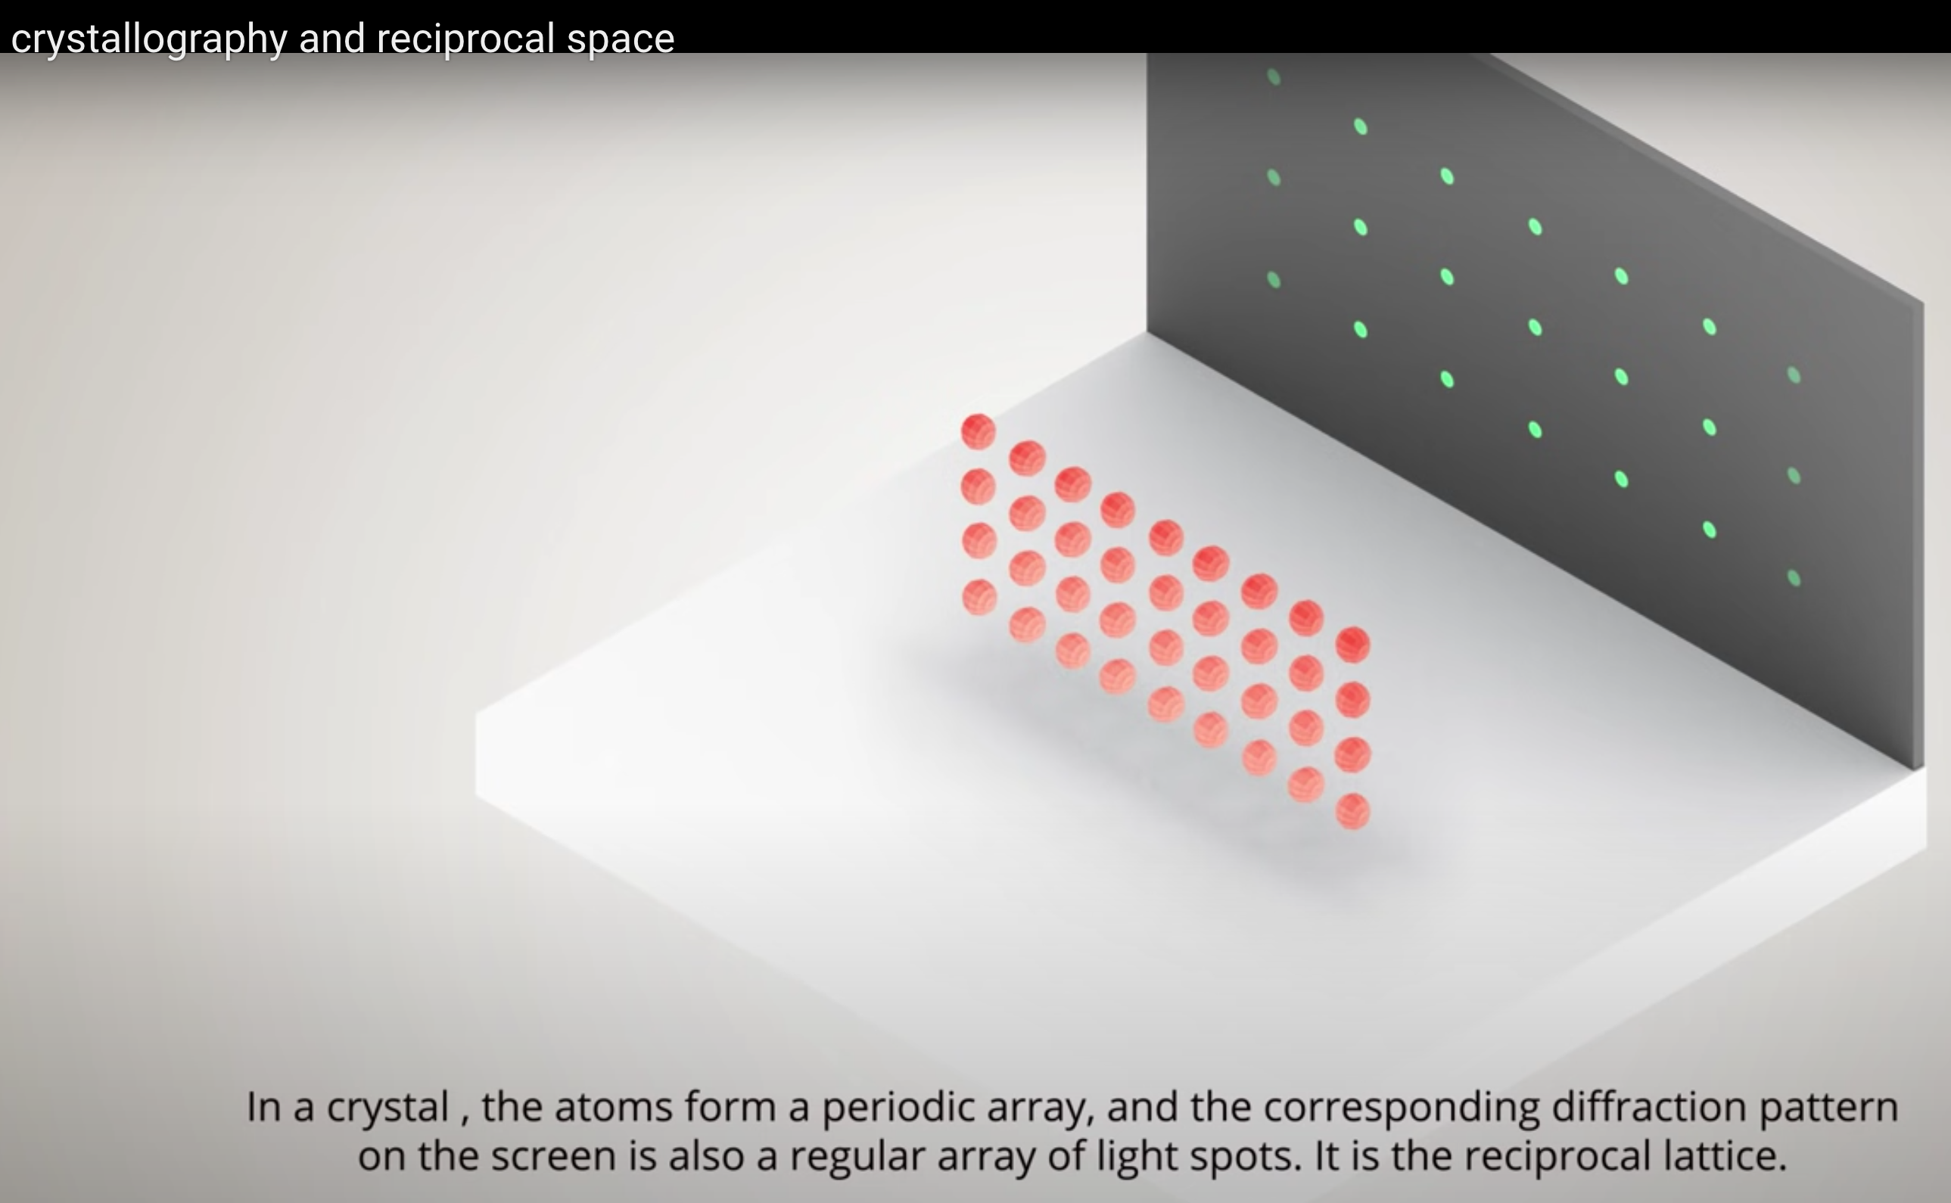
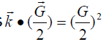
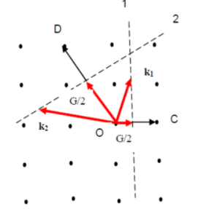
Concepts of Brillouin Zone
Construction of a Wigner-Seitz cell in the reciprocal lattice (First Brillouin zone):
To construct the first Brillouin zone, we need to find the link between the incident beam (like electron or neutron or phonon beam) of wave vector k and the reciprocal lattice vector G. This relation may be found as
[for example, an x-ray beam in the crystal will be diffracted if its
wave vector k has the magnitude and direction required
by this latter relation].
Thus the procedure to build up the first Brillouin zone is as follows:
Select a vector G from the origin to a reciprocal lattice point.
Construct a plane normal to the vector G at its mid point. This plane forms a part of the zone boundary.
The diffracted beam will be in the direction k -G .
Thus the Brillouin construction exhibits all the wave vectors k which can be Bragg-reflected by the crystal.
Important Note: A wave whose wave vector drawn from the origin terminates on any of the planes will satisfy the condition of diffraction. Such planes are the perpendicular bisectors of the reciprocal vectors.

Slide 7
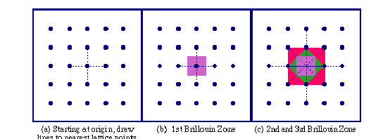
Concepts of Brillouin Zone
Remarks:
The planes divide the Fourier space of the crystal into fragments as shown for a square lattice.
- The central square is a primitive cell of the reciprocal lattice. It is a Wigner-Seitz cell of the reciprocal lattice (called the first Brillouin zone).
- The first Brillouin zone is the smallest volume entirely enclosed by the planes.

Slide 8
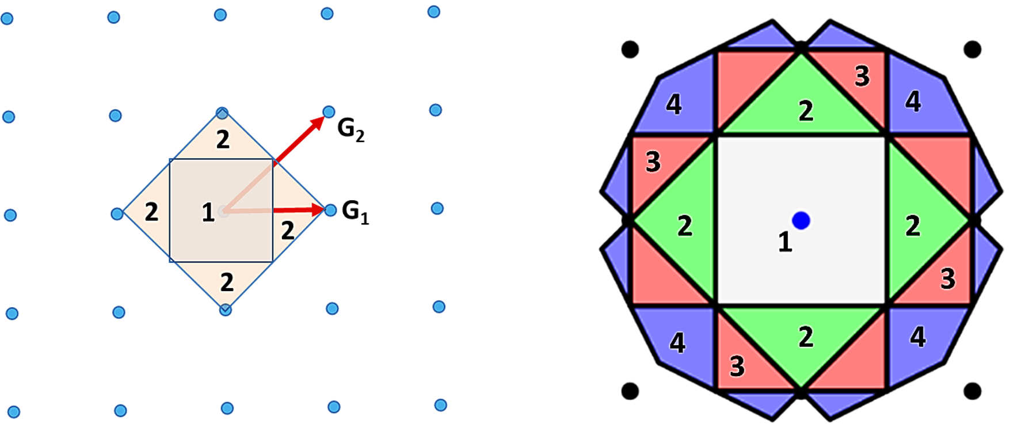
Construction of Brillouin Zone

Slide 9
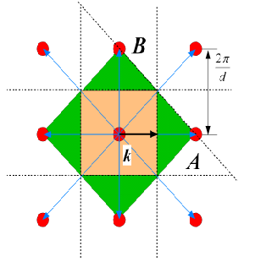
Determination of First Brillouin Zone
Select lattice point and draw a line segment to all neighbouring lattice points (blue).
Draw centre normal planes (black, dotted). In 2D they are lines.
The bounded area closest to the selected point is 1. Brillouin zone (orange).
The next area (going over one line only) is 2. Brillouin zone (green).

Slide 10
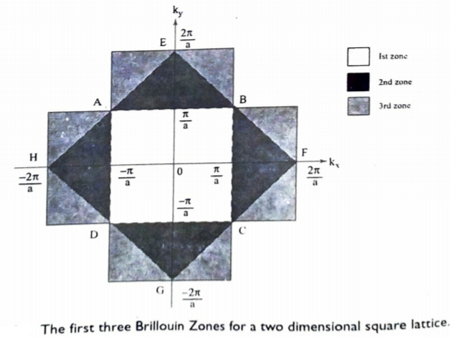
Importance of Brillouin Zone
Conclusion: Wigner-Seitz cell: smallest possible primitive cell, which consist of one lattice point and all the surrounding space closer to it than to any other point. The construction of the W-S cell in the reciprocal lattice delivers the first Brillouin zone (important for diffraction).
Importance: The Brillouin zones are used to describe and analyse the electron energy in the band energy structure of crystals.

Slide 11

Questions & Feedback, Please!

